Slide 1


Laura M.
May 17th, 2023

Slide 2

Outline
Executive Summary
Introduction
Methodology
Results
Conclusion
Appendix

Slide 3
Executive Summary
SpaceX advertises the reusage of the first stage improving the cost of rocket launches. With the data available from these launches for the Falcon 9, we can try to find out through Machine Learning tools, if the rocket will land or not by considering variables such as; PayloadMass, Orbit, LaunchSite, Outcome, Class, among others.
Exploratory Data Analysis was done before the model, in which was found that launch sites KSC LC-39A and VAFB SLC 4E have the highest success rate with 77%.
Launch sites are located close to coast lines and railways, distanced from cities.
Orbits VLEO, SSO, HEO, GEO and ES-L1 have a higher success rate between 80% and 100%.
The success rate since 2013 kept increasing onwards until 2020.
From the machine learning model, the methods that perform best are Logistic Regression and SVM with an accuracy metric of 94% of the model against the test data.

Slide 4
Introduction
SpaceX is a North American company that promotes cost saving rocket launches by reusing the first stage. Through Python and machine learning tools we can take a data set using web scraping to gather information from different launches and analyze it to obtain patterns and get predictions.
We are looking to determine if the landing of the first stage is successful for the Falcon 9 rocket, if so, we can determine the cost of the launch and provide this useful information to alternate companies that are looking to execute rocket launches whilst saving costs in the process.

Slide 5

Section 1

Slide 6
Methodology
Executive Summary
Data collection methodology:
The data collection was obtained by making a request to the SpaceX API using Python and then, the Falcon 9 launch record were extracted from Wikipedia through web scrapping using Python the library BeautifulSoup
Perform data wrangling
To begin with data wrangling missing values were checked and for the numeric column data (PayloadMass) the missing values were replace by its respective mean
Perform exploratory data analysis (EDA) using visualization and SQL
Perform interactive visual analytics using Folium and Plotly Dash
Perform predictive analysis using classification models
Logistic Regression, SVM, Decision Tree, KNN were implemented

Slide 7
Data Collection
The datasets were collected by making a request to SpaceX’s API through Python and using the respective URL. After this, data cleaning and data wrangling was done.
The steps in the flowchart sum up this part of the process.
Data Collection
Get request to SpaceX API
Get response code:
Successful request. Continue to decode
Yes
Is it 200?
No
Decode the response content as a Json file
Turn the Json file into a Pandas dataframe
Data cleaning
Replace with mean value
Is there any missing data?
Data collected
Yes
Data wrangling
Continue with data wrangling
No

Slide 8
Data Collection – SpaceX API
Load requests library, that will make HTTP requests to get the data from the API + Pandas/NumPy
Get the URL and call the API where data is available
200 means the request was successful
Check the content obtained
Convert the successful response to Json
Then turn it into a Pandas dataframe
Print & begin with the data cleaning and wrangling making sure data makes sense and is valid.
Data Collection: SpaceX API
Load requests
1
response = requests.get()
2
Check status with .status_code
4
3
Yes
200?
No
response.content
Continue to data cleaning & wrangling
.json()
.json_normalize()
7
5
6
The GitHub URL of the completed SpaceX API calls notebook is available at: https://tinyurl.com/96kjewaf

Slide 9
Data Collection - Scraping
Load main libraries
Get a response from the static URL and request the HTML page, using requests.get()
Check the content
Create a BeautifulSoup object
Find tables from source with .find_all('table')
select the target table with html_tables[target]
Extract all column names from the HTML table header
Create a data frame by parsing the launch HTML tables
Web Scraping
1
2
3
Load requests and BeautifulSoup
response = requests.get()
response.content
5
6
html_tables[target]
.find_all('table')
soup = BeautifulSoup()
4
7
Extract column names
Create data frame
8
Data collected
The GitHub URL of the completed SpaceX web scraping notebook is available at: https://tinyurl.com/4rapmsf7

Slide 10
Data Wrangling
Identified the different types of columns
Calculated the number and occurrence of each orbit with .value_counts()
Calculated the number and occurrence of mission outcome of the orbits with .value_counts()
Created a landing outcome label from Outcome column
The GitHub URL of the completed SpaceX web scraping notebook is available at: https://tinyurl.com/4rapmsf7

Slide 11
EDA with Data Visualization
One chart type chosen was a scatter plot since it was easier to see the relationship between three variables, such as; Launch Sites (categorical), Payload Mass (numerical) and Class a numerical type which tell us if the launch was successful or not, it was converted from categorical type using One Hot Encoding.
Bar charts were implemented as well to compare between categories (i.e., Orbit) and numerical data (i.e., Success Rate).
Line plots were used as well to depict us the trend (i.e., Success Rate) throughout time.
The GitHub URL of the completed SpaceX EDA notebook is available at: https://tinyurl.com/pbmwy396

Slide 12
EDA with SQL
Some of the SQL queries performed for this project were:
SELECT DISTINCT, to obtain unique launch site names.
WHERE, LIKE and LIMIT, to apply certain conditions, such as; launch sites that begin with certain string and display only a limited number of results from that query.
SUM() and AVG(), to display the total and average mass carried by boosters, for example.
MIN(), to obtain the minimum value of a numerical feature.
BETWEEN _ AND _, to display results within a certain range of values.
COUNT(), to get the total count of a categorical feature.
AS, to give a name to the result column for better understanding.
GROUP BY, to group the query results by categories.
The GitHub URL of the completed SpaceX EDA with SQL notebook is available at: https://tinyurl.com/yavspkxz

Slide 13
Build an Interactive Map with Folium
0bjects created with Folium:
A site map object was created to locate all coordinate points in.
Map markers to create labels for the points in certain coordinates.
Circles were created to surround the area around NASA Space Center’s coordinates.
MarkerCluster to simplify a map containing many markers having the same coordinate.
A mouse position object to get the coordinate for a mouse over on the map.
Poly Line object was created to connect the coastline coordinates to launch sites.
The GitHub URL of the SpaceX interactive map with Folium notebook is available at: https://tinyurl.com/mte2zuta

Slide 14
Build a Dashboard with Plotly Dash
A scatter chart to show the correlation between payload and launch success was added.
A pie chart to show the total successful launches count for all sites was added.
Implemented a dropdown list to enable launch site selection for the user.
Implemented a slider to select payload range.
Callback functions to determine the site dropdown and payload slider as input and the scatter chart and pie chart as outputs were defined.
The GitHub URL of the SpaceX Dashboard with Plotly Dash notebook is available at: https://tinyurl.com/2jzk82ak

Slide 15
Predictive Analysis (Classification)
Type casting was firstly introduced into the data preparation for model predictions.
Data standardized and transformed using StandardScaler and fit_transform.
The data was split into train and test data.
The best parameters were obtained using GridSearchCV through different estimators such as: Logistic Gegression, SVC, Decision Tree and, Kneighbours.
The model was trained in test data with the best parameters.
Results were compared to find the method that performs best.
The GitHub URL of the SpaceX Dashboard with Plotly Dash notebook is available at: https://tinyurl.com/4wrzcrhx

Slide 16
Results
It was found that the launch sites with highest success rates are KSC LC-39A and VAFB SLC 4E.
There are no rockets launched for payload mass greater than 10000.
Orbits with highest success rates are VLEO, SSO, HEO, GEO and ES-L1.
The success rate kept increasing since 2013 until 2020.
The best model performance was found in machine learning models with the Logistic Regression, SVM and Decision Tree Classifier methods, with a score of 94.4%, 94.4% and 83.3%, respectively.
Machine learning model with the Kneighbours method was found to be overfitting.

Slide 17

Section 2

Slide 18
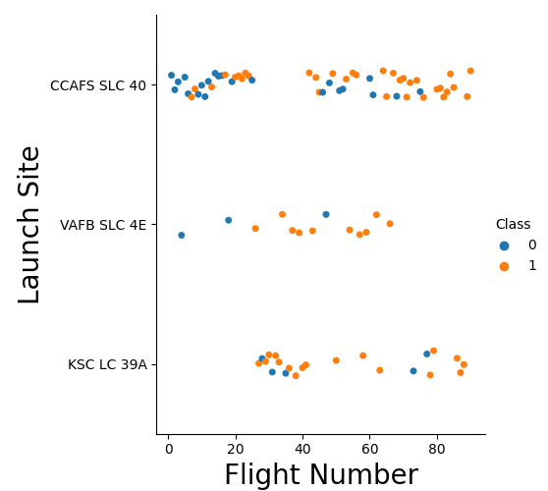
Flight Number vs. Launch Site
From this plot we can see that CCAFS LC-40 has a success rate of 60%
KSC LC-39A has a success rate of 77%
VAFB SLC 4E has a success rate of 77%

Slide 19
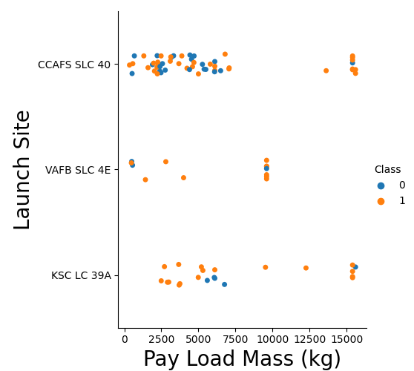
Payload vs. Launch Site
The VAFB-SLC launch site has no rockets launched for heavy payload mass, greater than 10000 kg.

Slide 20
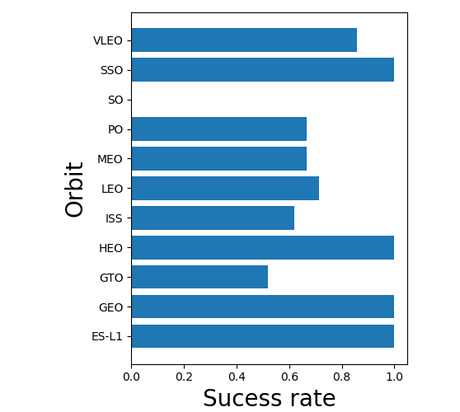
Success Rate vs. Orbit Type
The orbits SSO, HEO, GEO, ES-L1 have the highest success rate with 100%, and VLEO with ~80%.

Slide 21
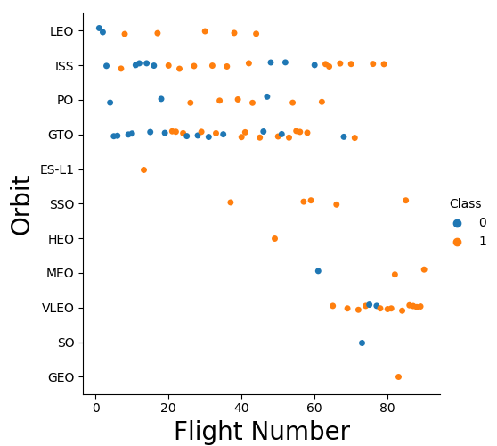
Flight Number vs. Orbit Type
For the LEO orbit the success appears to be related to the number of flights.
There seems to be no relationship between flight number when in GTO orbit.

Slide 22
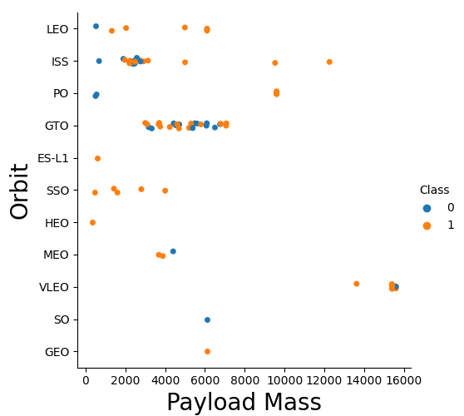
Payload vs. Orbit Type
The orbits Polar (PO), LEO and ISS have more successful landings with heavy payloads.
For GTO we cannot distinguish well the relationship between landing rate and payload mass since both categories are present, more like 50/50.

Slide 23
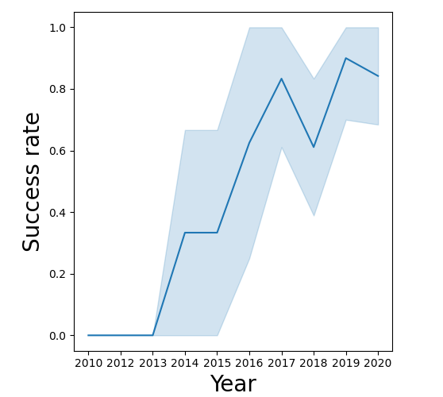
Launch Success Yearly Trend
Success rate is increasing consistently from 2013 to 2020.

Slide 24
All Launch Site Names
All the unique launch site names are:
CCAFS LC-40
VAFB SLC-4E
KSC LC-39A
CCAFS SLC-40
To get this result, the SQL queries implemented were:
SELECT, DISTINCT, FROM

Slide 25
Launch Site Names Begin with 'CCA'
To get this result, the SQL queries implemented were:
SELECT, FROM, WHERE, LIKE, LIMIT
Date | Time (UTC) | Booster_Version | Launch_Site | Payload | PAYLOAD_ MASS__KG_ | Orbit | Customer | Mission_ Outcome | Landing _Outcome
4/6/2010 | 18:45:00 | F9 v1.0 B0003 | CCAFS LC-40 | Dragon Spacecraft Qualification Unit | 0 | LEO | SpaceX | Success | Failure (parachute)
8/12/2010 | 15:43:00 | F9 v1.0 B0004 | CCAFS LC-40 | Dragon demo flight C1, two CubeSats, barrel of Brouere cheese | 0 | LEO (ISS) | NASA (COTS) NRO | Success | Failure (parachute)
22/05/2012 | 7:44:00 | F9 v1.0 B0005 | CCAFS LC-40 | Dragon demo flight C2 | 525 | LEO (ISS) | NASA (COTS) | Success | No attempt
8/10/2012 | 0:35:00 | F9 v1.0 B0006 | CCAFS LC-40 | SpaceX CRS-1 | 500 | LEO (ISS) | NASA (CRS) | Success | No attempt
1/3/2013 | 15:10:00 | F9 v1.0 B0007 | CCAFS LC-40 | SpaceX CRS-2 | 677 | LEO (ISS) | NASA (CRS) | Success | No attempt

Slide 26
Total Payload Mass
The total payload carried by boosters from NASA is equal to 45596 kg.
To get this result, the SQL queries implemented were:
SELECT, SUM(), FROM, WHERE

Slide 27
Average Payload Mass by F9 v1.1
The average payload mass carried by booster version F9 v1.1 is equal to 2928.4 kg.
To get this result, the SQL queries implemented were:
SELECT, SUM(), FROM, WHERE

Slide 28
First Successful Ground Landing Date
The dates of the first successful landing outcome on ground pad, was on 01-05-2017.
To get this result, the SQL queries implemented were:
SELECT, MIN(), FROM, WHERE

Slide 29
Successful Drone Ship Landing with Payload between 4000 and 6000
The names of boosters which have successfully landed on drone ship and had payload mass greater than 4000 but less than 6000 are:
F9 FT B1022
F9 FT B1026
F9 FT B1021.2
F9 FT B1031.2
To get this result, the SQL queries implemented were:
SELECT, FROM, WHERE, AND, BETWEEN

Slide 30
Total Number of Successful and Failure Mission Outcomes
The total number of successful and failure mission outcomes is: 100 successes and 1 failure.
To get this result, the SQL queries implemented were:
SELECT, COUNT(), AS, FROM, WHERE, LIKE

Slide 31
Boosters Carried Maximum Payload
The names of the booster which have carried the maximum payload mass are:
To get this result, the SQL queries implemented were:
SELECT, FROM, WHERE

Slide 32
2015 Launch Records
The failed landing_outcomes in drone ship, their booster versions, and launch site names year 2015 are:
To get this result, the SQL queries implemented were:
SELECT, AS, FROM, WHERE

Slide 33
Rank Landing Outcomes Between 2010-06-04 and 2017-03-20
Rank the count of landing outcomes (such as Failure (drone ship) or Success (ground pad)) between the date 2010-06-04 and 2017-03-20, in descending order
To get this result, the SQL queries implemented were:
SELECT, SUM(), FROM, WHERE

Slide 34

Section 3

Slide 35
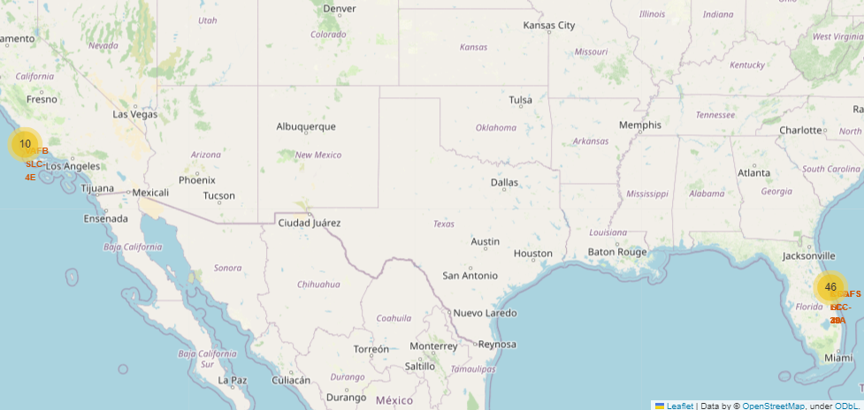
Launch Sites Location
We can see on a large scale that launch sites are distributed in 2 main areas:
A group of 10 different locations are to the west side of the U.S.
46 points located in the east side of the U.S.
Both groups are located near the coastline.

Slide 36
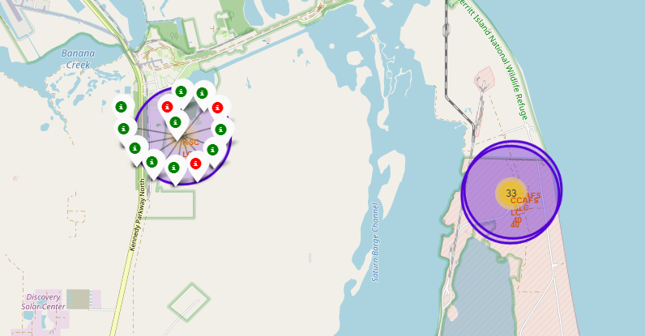
Launch Outcomes for Launch Sites
For the launch site KSC LC-39A we can see the outcomes which are shown in green color if the launch was successful or red if it failed.

Slide 37
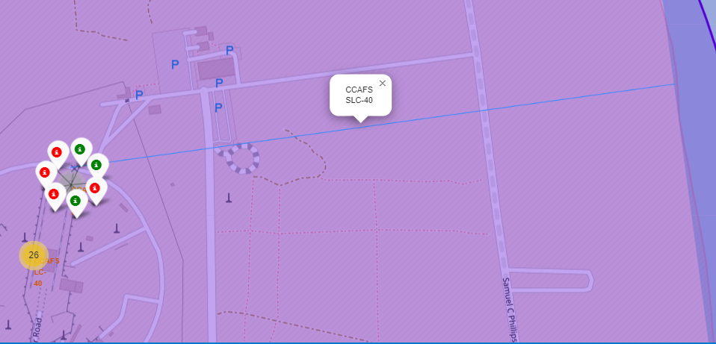
Distance between two points
For the launch site CCAFS SLC-40 we can calculate in Folium the distance form the launch site to the coastline through the continuous blue line in the map between these points. The distance between these two points is equal to 0.856 meters.

Slide 38

Section 4

Slide 39
<Dashboard Screenshot 1>
Replace <Dashboard screenshot 1> title with an appropriate title
Show the screenshot of launch success count for all sites, in a piechart
Explain the important elements and findings on the screenshot

Slide 40
<Dashboard Screenshot 2>
Replace <Dashboard screenshot 2> title with an appropriate title
Show the screenshot of the piechart for the launch site with highest launch success ratio
Explain the important elements and findings on the screenshot

Slide 41
<Dashboard Screenshot 3>
Replace <Dashboard screenshot 3> title with an appropriate title
Show screenshots of Payload vs. Launch Outcome scatter plot for all sites, with different payload selected in the range slider
Explain the important elements and findings on the screenshot, such as which payload range or booster version have the largest success rate, etc.

Slide 42

Section 5

Slide 43
Classification Accuracy
Visualize the built model accuracy for all built classification models, in a bar chart
Find which model has the highest classification accuracy

Slide 44
Confusion Matrix
Show the confusion matrix of the best performing model with an explanation

Slide 45
Conclusions
Point 1
Point 2
Point 3
Point 4
…

Slide 46
Appendix
GitHub repository: Lau397/DataScience_SpaceX (github.com)

Slide 47


